Slide 1


Container Runtimes And Kubernetes
For faster and flexible runtime..
Presented by Fahed Dorgaa
02/11/2019

Slide 2




Whoami ?
Fahed Dorgaa
DevOps Engineer / Cloud Designer
fahed.dorgaa@gmail.com
https://www.linkedin.com/in/fahed-dorgaa-773283111/
https://twitter.com/DorgaaFahed

Slide 3
Table of Contents
What is Container Runtime ?
What is Container Runtime Interface ?
Why use Container Runtime Interface ?
What is the best Container Runtime solution?
Cri & Cni

Slide 4
What is Container Runtime ?

Slide 5
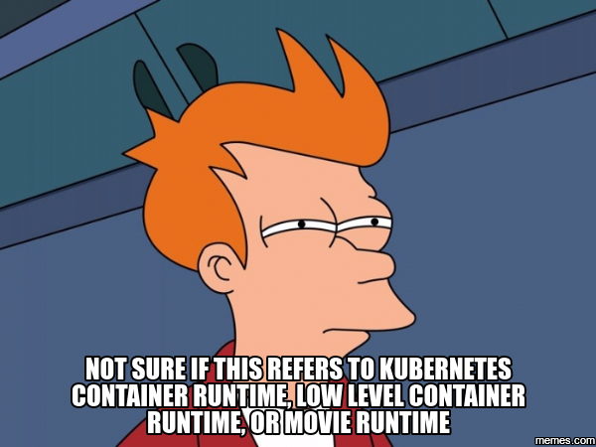
Container Runtime

Slide 6
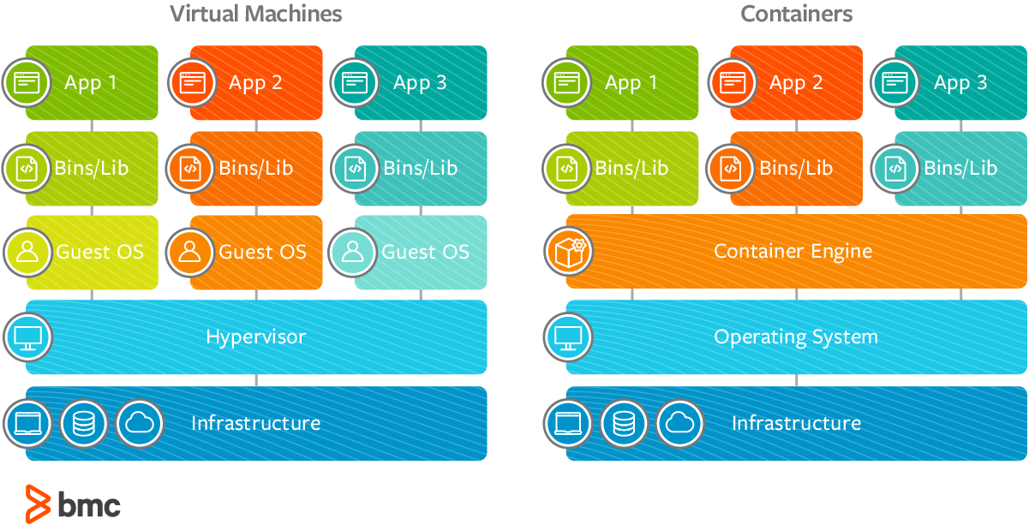
The way to the definition

Slide 7
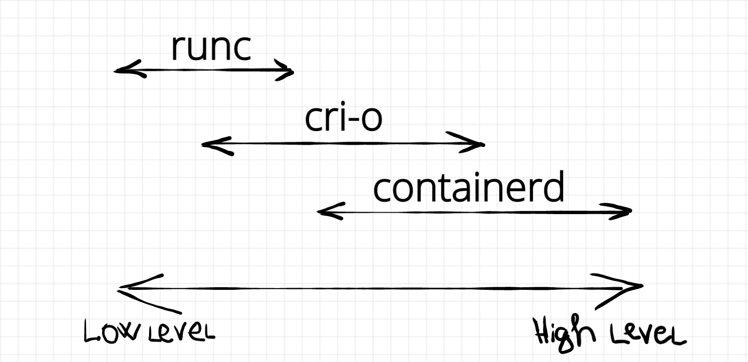
Types of Container Runtimes

Slide 8
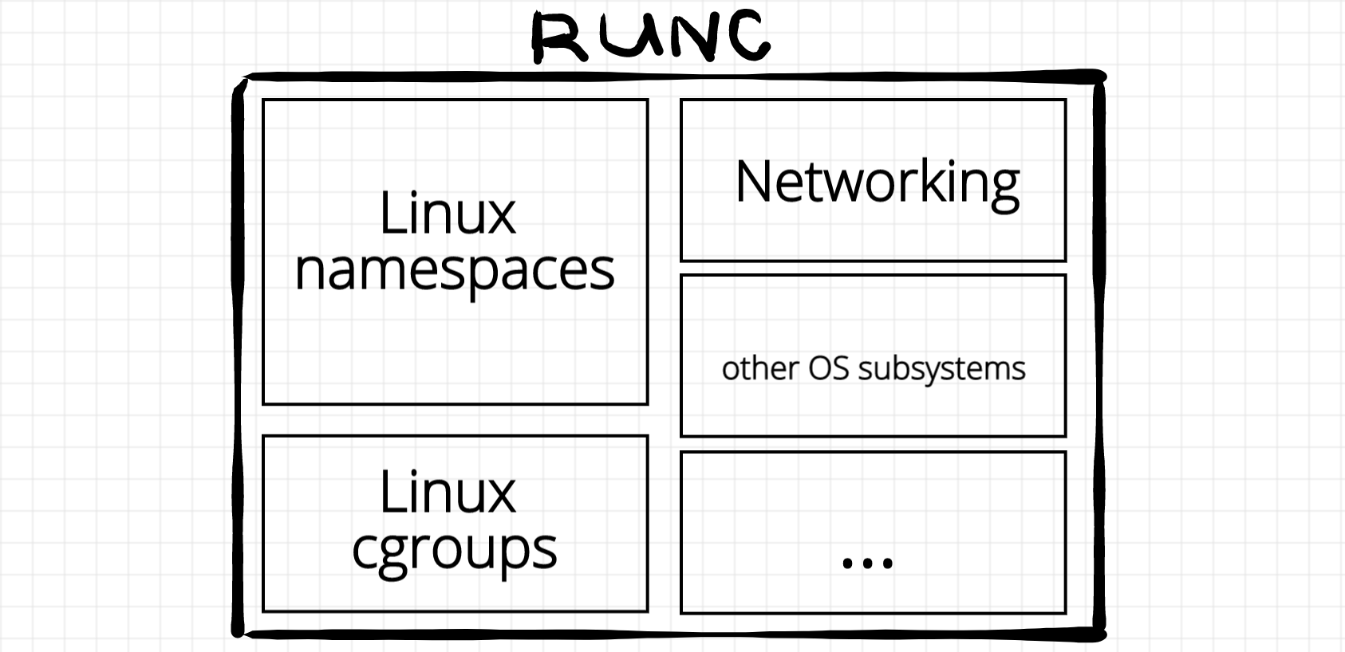
Overview of low level container runtime

Slide 9
So..What is Container Runtime ?!
A container runtime is software that executes containers and manages container images on a node.

Slide 10
What is Container Runtime Interface ?

Slide 11
Container Runtime Interface (CRI)
The interface between client and container runtime
With CRI kubernetes can communicate with multiple container runtime
With CRI client like kubelet, kubernetes can communicate with runtime ( e.g kata runc) in order to create and generate container in the OS layer.

Slide 12
Why use Container Runtime Interface ?

Slide 13
CRI in Kubernetes
Making the abstraction between kubernetes and the container runtime.
Lower memory/CPU usage.
Clean API for extensibility and embedding

Slide 14
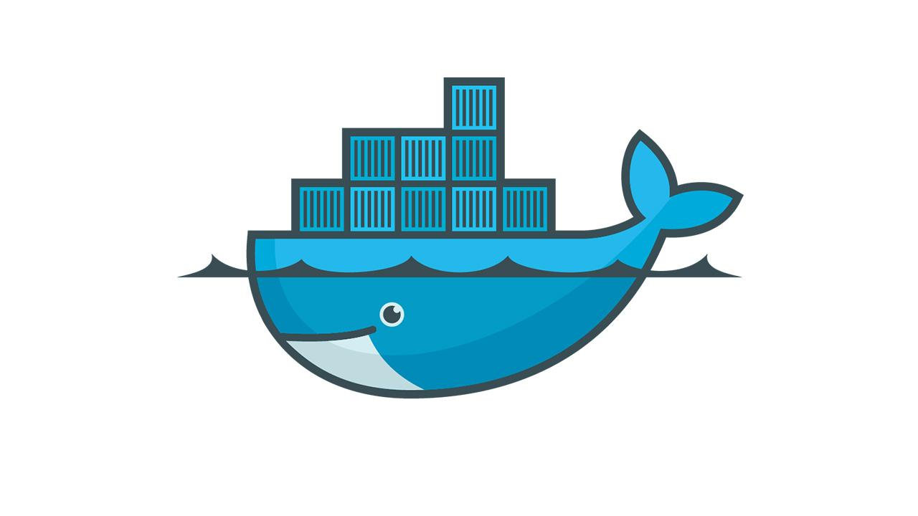
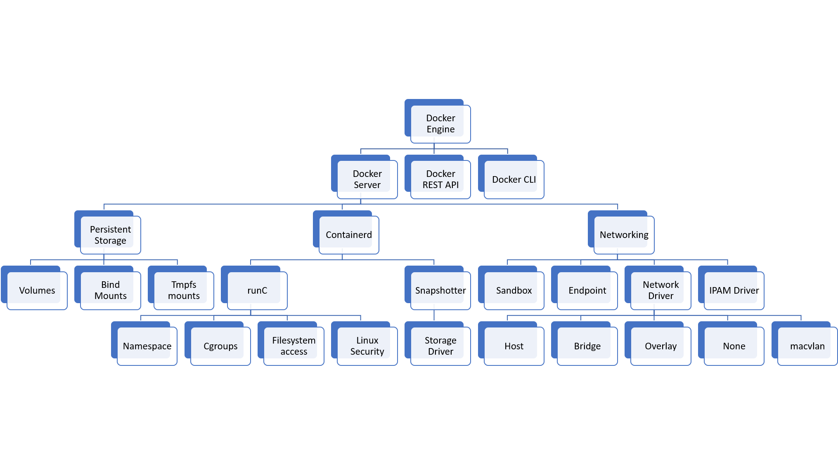
DOCKER

Slide 15

What would I need ?

Slide 16
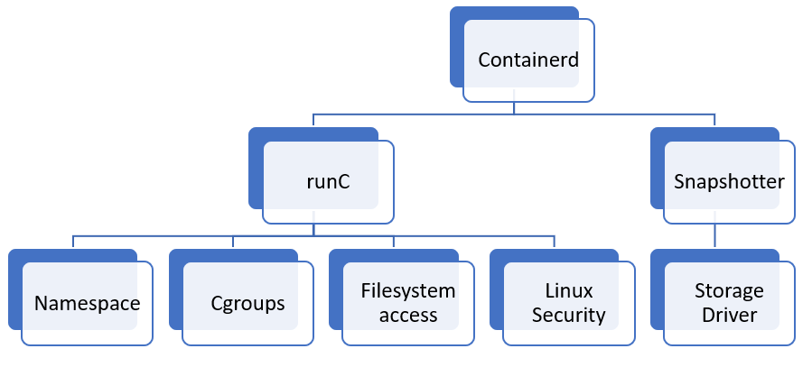
DOCKER

Slide 17
Docker in kubernetes ecosystem..
Docker is more than enough for kubernetes.
Mismatch of release sync between docker and kubernetes.
Extra memory/CPU use due to extra layer with docker

Slide 18
What is the best Container Runtime solution ?

Slide 19


Containerd (CRI runtime solution)
Graduated by CNCF on February 28, 2019.
Containerd is an OCI compliant core container runtime designed to be embedded into larger systems
Comparing by Docker containerd provides the minimum set of functionality to execute containers and manage images on node.

Slide 20
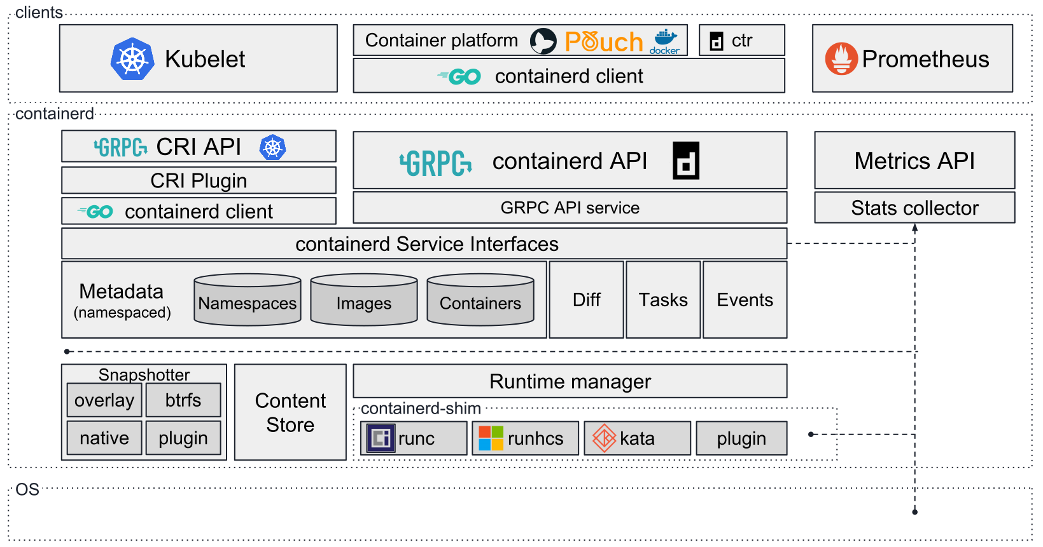
Containerd architecture

Slide 21
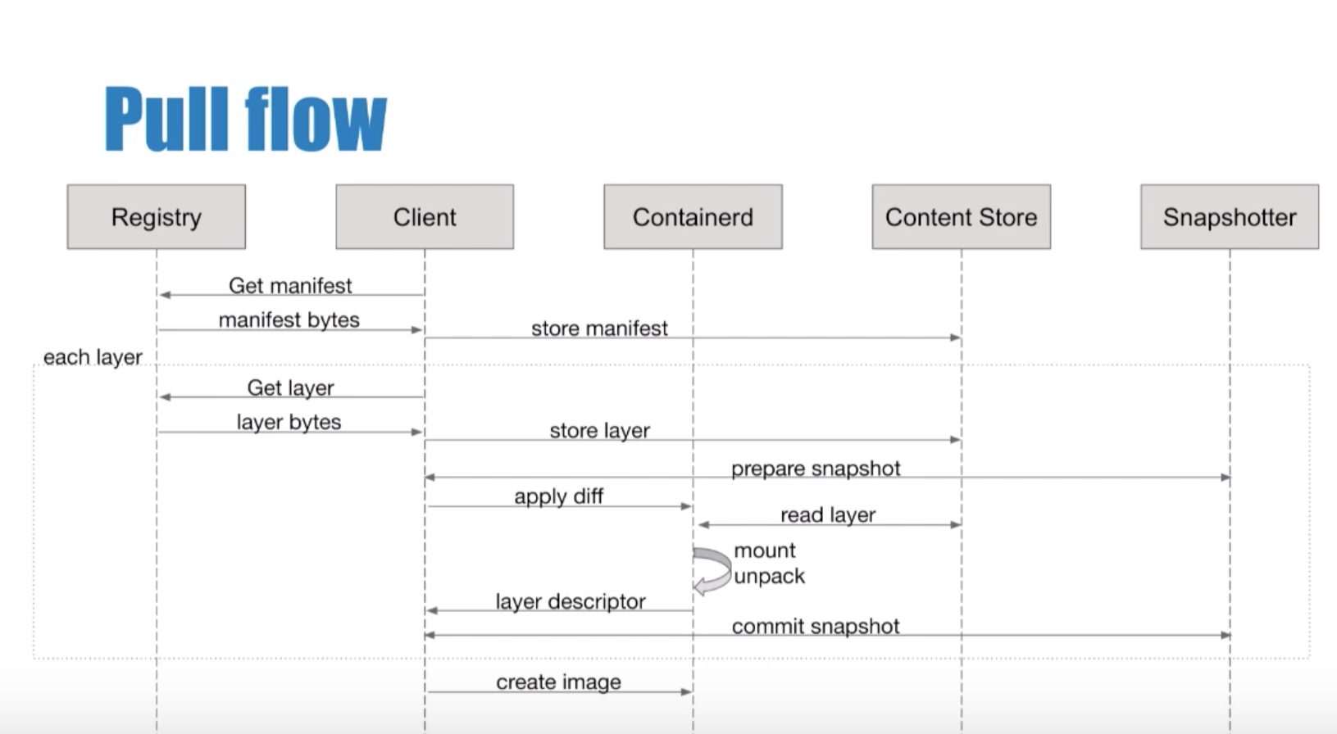
Containerd Pull flow

Slide 22
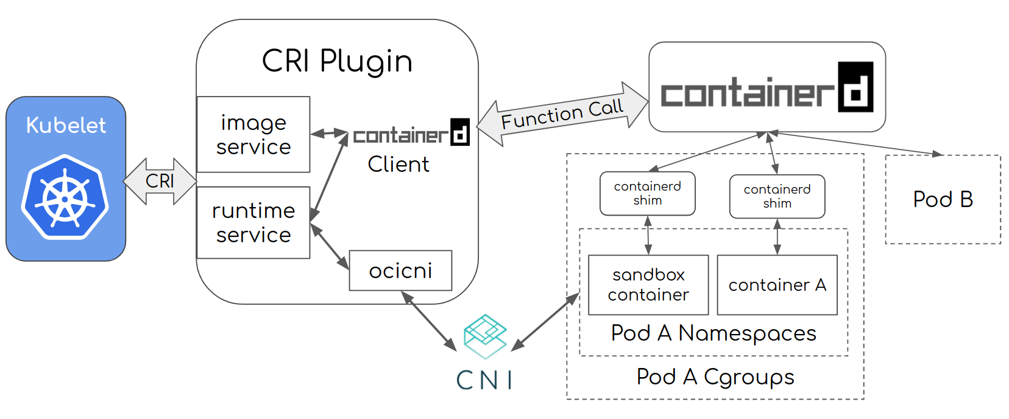
Integration of Containerd in kubernetes

Slide 23
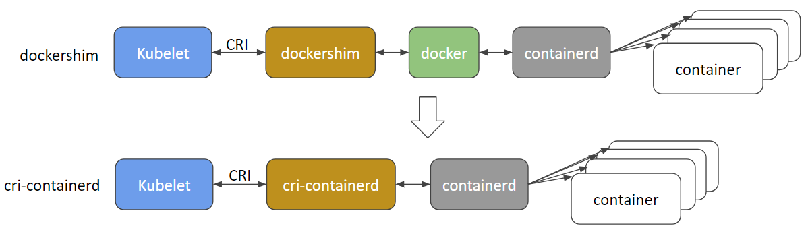
Containerd vs. Docker
Compared with the current Docker CRI implementation (dockershim), cri-containerd eliminates an extra hop in the stack, making the stack more stable and efficient.

Slide 24

CRI-O
CRI-O is a Cloud Native Computing Foundation incubating project.
CRI-O implements the Kubelet Container Runtime Interface (CRI) using OCI
Comparing by Docker CRI-O provides the minimum set of functionality to execute containers and manage images on node.

Slide 25
Cri-Containerd vs Cri-o (Bucketbench)
Solution | 1 thrd | 2 thrd | 3 thrd | 4 thrd | 5 thrd | 6 thrd | 7 thrd | 8 thrd | 9 thrd | 10 thrd
Cri-o | 0.08 | 0.13 | 0.18
CRIContainerd | 0.14 | 0.25 | 0.35 | 0.44 | 0.49

Slide 26
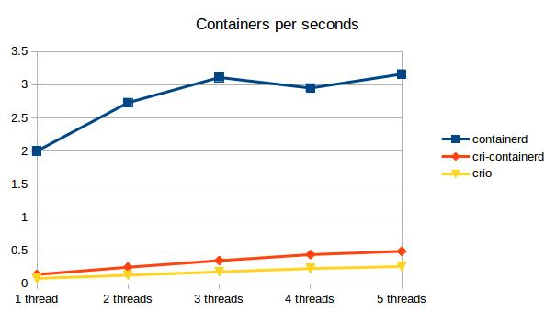
Cri-Containerd vs Cri-o

Slide 27
Container runtime interface
And
Container network interface

Slide 28
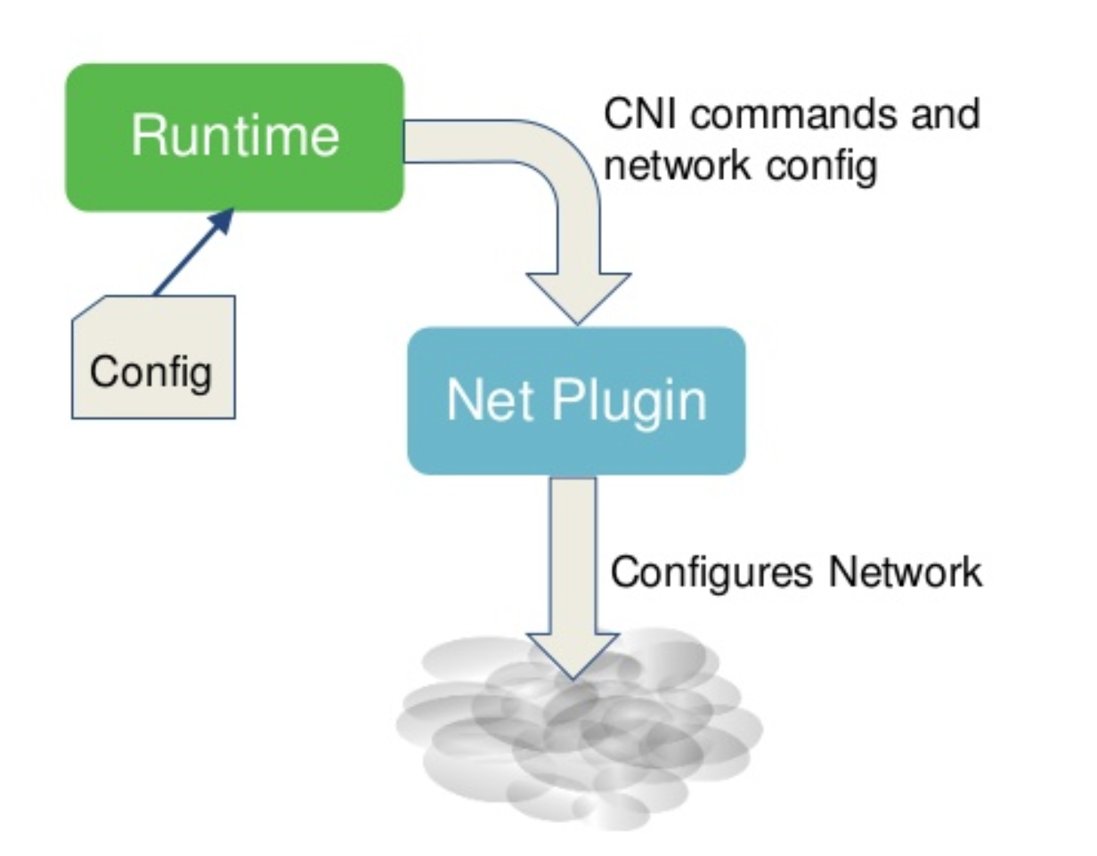
Cri & Cni
Container runtime provides the right configuration to the Container network interface plugin.
Container runtime invokes Network Plugin (bridge) when container is ADDeD.
Container runtime will create network namespaces with the help of the network plugin.
Container network interface Identify the network the container must attach to

Slide 29

Demo

Slide 30
Conclusion
Q/R

